Slide 1

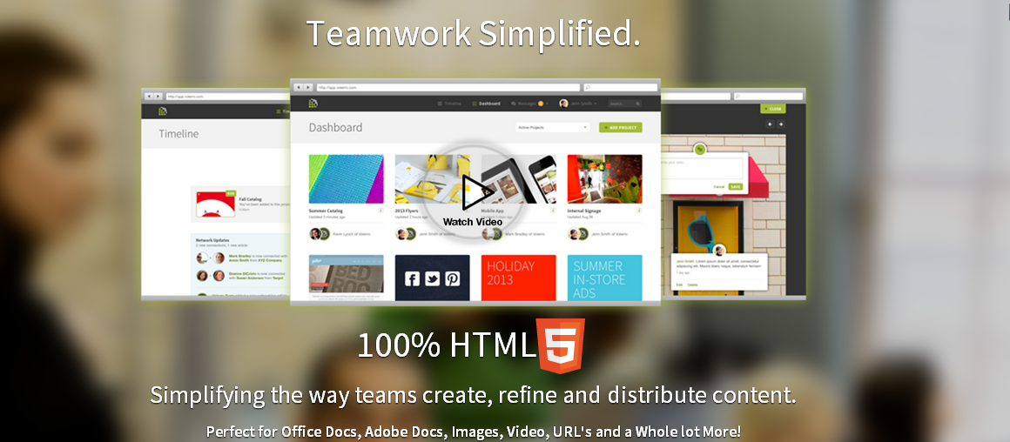
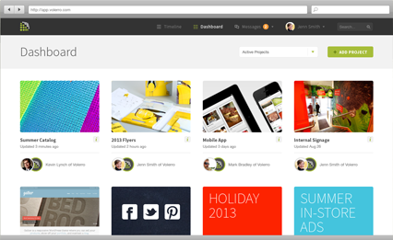
Rick Kelley, SVP
rkelley@volerro.com
612-860-8477
Kevin Lynch, CEO
klynch@volerro.com
612-834-1818

Slide 2
Agenda
Introductions
Overview of Volerro
Next Steps

Slide 3


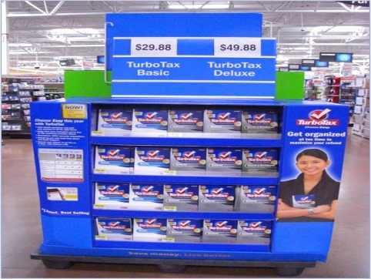


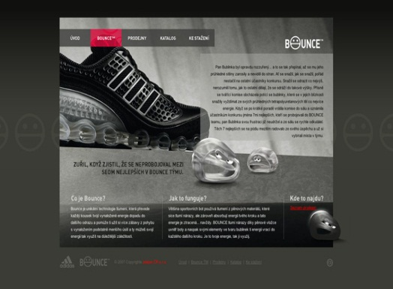
Going to Market is Hard Work
Consumer Packaging
Sales Collateral
In-Store Promotions
Demo/Benefit Videos
Web, Mobile &Social Sites
TV, Radio, Print Ads
Notes:
15 seconds – elapsed 30 seconds
In our work life and personal life we’re constantly a target of marketers
From packaging to social – someone always wants us to notice them
But have you ever thought about the teams who make all this stuff – and coordinating it across all these channels?

Slide 4

Creative Work Takes Time & Money
In 2013, More than $118 billion was be spent on content marketing,
video marketing and social media
(Source eMarketer)
Notes:
15 seconds – elapsed 45 seconds
Take Charles Schwabs recent Accountability campaign – here’s the print version
They launched this across all of their marketing channels from print & TV to web and social
This takes an incredible amount of tedious work and coordination
Somebody has to write the words, take the pictures, shoot the video, design the website
…and it all has to be coordinated across a schedule
All this work costs companies $118B in 2013

Slide 5
Stakeholders Need to Weigh In
Product Teams
Sales Teams
Legal & Compliance
Outside Creative
…Yet Most Companies Lack an Integrated System to Manage all of This Creative Work
61% of companies lack the tools to create the kind of content that people want
(Source: content marketing institute)
Notes:
15 seconds – elapsed 1 minute
And to make matters worse – everything has to be approved by somebody else
Getting approval can actually take a lot of time on a complex file like a video or a website
You’d think there’d be a production system to keep all this on track – but there isn’t

Slide 6
The Result: Content Production Chaos
“The shared calendar is out of sync with the project management system again…”
“…I Don’t have Adobe Illustrator on my computer can you convert to PDF?”
“Who has the document markups and suggestions we scanned in from the product and legal teams…”
“…This Video won’t play on my iPad”
“…Which folder did we use for last year’s back-to-school campaign, I want to re-use the concept”
“The production milestones have changed; here’s a copy of the new milestones exported to excel…”
Notes:
15 seconds – elapsed 1:15
The result is what we like to call “Content Chaos”
Large files, like video being shared on non-secure sites like Youtube
Website prototypes being served on some crazy local server with an ip address nobody can remember
Shared calendars being managed via spreadsheets
This is wasting time and money

Slide 7











Volerro’s Solution
Plan and Schedule
Manage Resources and Tasks
Upload, Preview, Comment & Annotate
Teleconference & Chat
Complete Cloud Service Designed to End Content Chaos
Notes:
45 seconds – elapsed 2 min
We built Volerro to solve this “Content Chaos”
An integrated calendar allows everyone to coordinate timelines and schedules
Flexible workflows allows team members to establish efficient stages for different types of projects
Preview and Annotation features ensure that everything is in one place
We even have a PowerPoint slide library that allows Marketing to Distribute Approved Slides to Sales
Built in Chat and Teleconferencing keep team members in touch to speed communication
Full project management features ensure everything stays on track

Slide 8
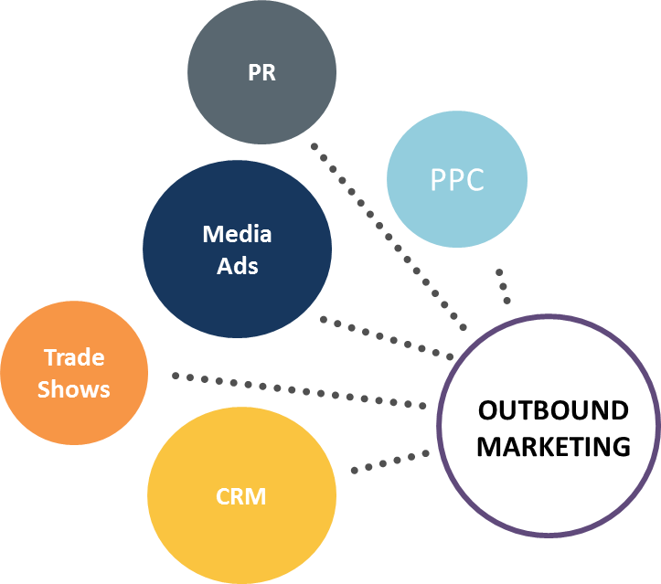
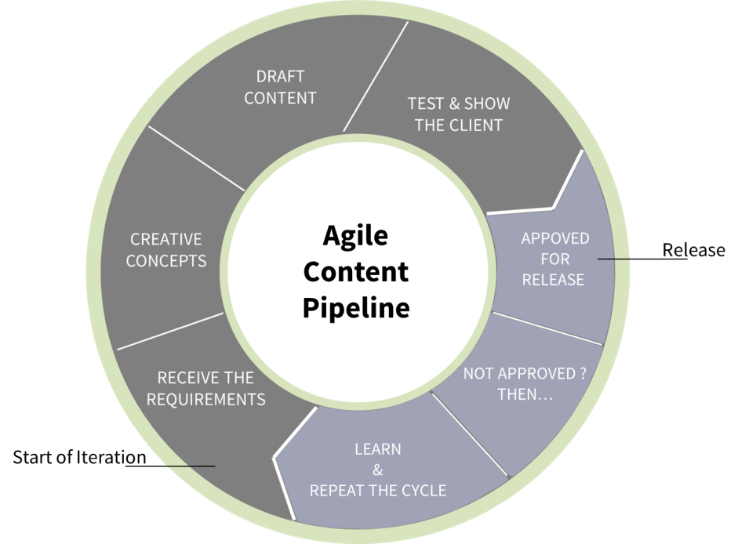
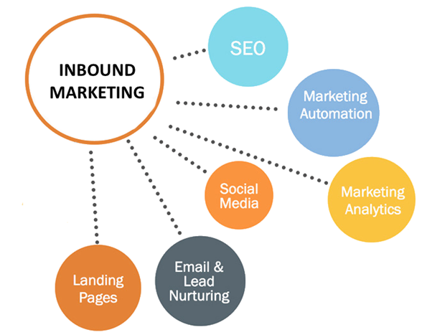
Where We Fit
Content Delivered
To Inbound & Outbound
Marketing Channels
Analytics From
Inbound & Outbound Channels
Creates Data for Measurement

Slide 9
Content Pipeline vs. Content Chaos
Product
Management
Product
Marketing
Marketing
& Marcom
Legal
& Compliance
Sales Enablement
& Sales
Operations
Efficient Content Pipeline
Customers
Features
Specifications
Roadmap
Release Dates
Pricing
Positioning
Competitive Data
Success Stories
Brand /Messaging
Creative/Production
Inbound Marketing
Outbound Marketing
Regulatory Issues
Product Claims
IP Rights
Safe Harbor
Sales Training
Lead Nurturing
Pitch Materials
Market Feedback
Simplifying the way teams create, refine and distribute content
Notes:
30 sec – elapsed 2:30
With Volerro, All the Needed Groups have access to a “Content Pipeline” from operations to sales
So they can weigh in from creative brief to finished marketing product
Increasing the quality of work
Ensuring Compliance
Reducing time to market
Lowering overall production costs

Slide 10
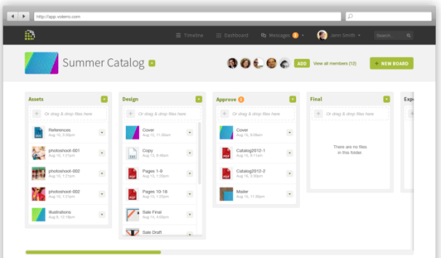
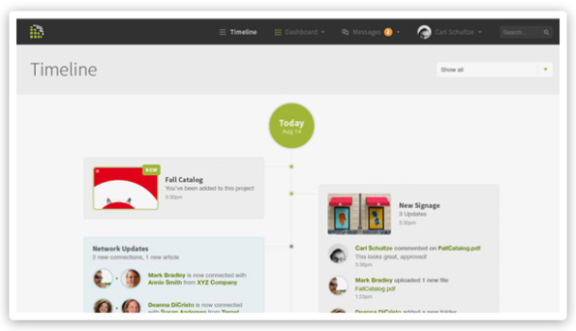
Sales Enablement
Volerro is designed to support the Sales Teams with better sales engagement to assist in improved sales productivity.
Build Presentations on the Fly with Approved Content
PowerPoint, Videos, PDF’s, Any Document Type
Create Deal and Opportunity Rooms
Client Engagement Tracking and Content Sharing
Sales Engagement Platform:
Presentation Follow Along
Content Feedback
Teleconferencing
Screen Sharing
Team Chat and Messaging
Present from Any Device Any Time
Salesforce Automation Integration

Slide 11


Competition
Too Complicated
Too Simplistic, Not Secure
Category | Feature | Sharepoint | BaseCamp | Volerro
Content Operations | Preview Any Document in Browser |  |  | ü
 | Annotate Anytype of Document |  |  | ü
 | Image, Video, Audio, URL Support | Limited | Limited | ü
 | File Version Management | ü |  | ü
 | Complex Search |  | ü | ü
 | Page Based Comments |  |  | ü
 | Free Proofing/Feedback Module |  |  | ü
 | RSS Outputs for Integration |  |  | ü
 | Assign Tasks from Comments/Annotations |  |  | ü
 | Advanced Tagging on Content and Projects | ü |  | ü
 | Email Content In |  |  | ü
Project Operations | Flexible Workflow Management |  | ü | ü
 | Kanban for Agile/Lean Methods |  |  | ü
 | Project/Portfolio Status at a Glance |  | ü | ü
 | Customizable Dashboard | ü |  | ü
 | Task Queues for Each Team Member |  |  | ü
 | Sub-Project Support and Roll-Up |  |  | ü
 | Start a Project with a Single Email |  |  | ü
Team & Scheduling | Project & Team Calendars |  | ü | ü
 | Team Resource Management |  |  | ü
 | Team Capacity Reports |  |  | ü
 | LDAP and SSO Support | ü |  | ü
Notes:
1 min – elapsed 6 min
Enterprise Marketing Teams are Familiar with two potential solutions, SharePoint and Basecamp
The IT department recommends SharePoint because they usually already have it – it’s a $2B market for Microsoft
While IT loves SharePoint because it’s a customizable platform, users hate it because it’s incredibly complicated to use and wont handle highly graphical or video files
Small creative firms love Basecamp because it’s incredibly simple to use as a replacement for email.
Basecamp has sold an estimated 7 million copies since they were founded in 1999
But Basecamp is too simple to manage the 1000’s of projects an enterprise Marketing team works on every year.
Basecamp lacks enterprise features like Single Sign On and their security model is wide open - So IT won’t endorse it in many cases
SharePoint is priced at between $10 and $15/seat, Basecamp is priced at about $2/seat, Volerro is priced at $7.99 per seat.
Neither of these Competitors Connect Marketing Teams with Their Sales Teams – A Key Pain Point for Our Customers

Slide 12
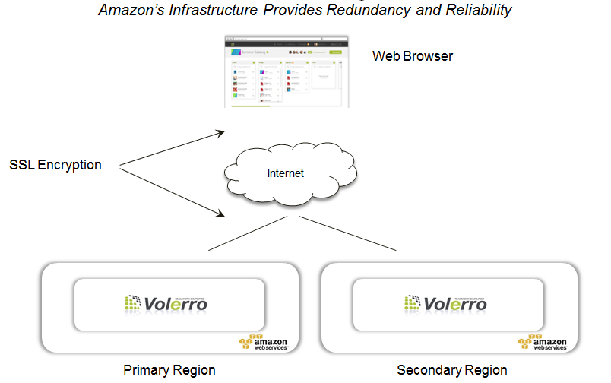
Secure Cloud
Volerro uses Amazon Web Services (AWS) to deliver our reliable cloud solution
We monitor AWS with our own third party security and availability services
Penetration tests, intrusion detection, virus detection etc. ensure security
Content is encrypted over the wire and when stored on disk
We’ve been certified for use by a Top 5 Domestic Bank

Slide 13
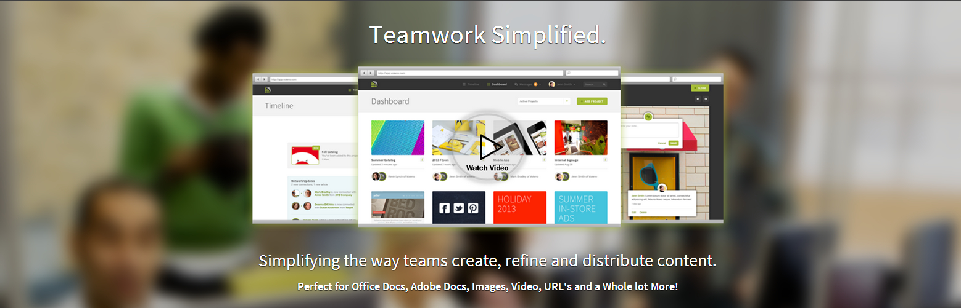
Conclusion

